Slide 1
India Air Quality index Analysis

Slide 2
Project Overview
This is a overall solution designed to collect, store and analyze air quality data from various monitoring stations across different states and cities.
The system aims to provide valuable insights into the air quality of different regions calling environmentalists, policymakers and the general public in making informed decisions regarding health and environmental concerns.

Slide 3
Data used
Air Quality Index of all stations across India

Slide 4
1.Retrieve all records from a specific city
Select * from AirQuality WHERE City="Mumbai";

Slide 5
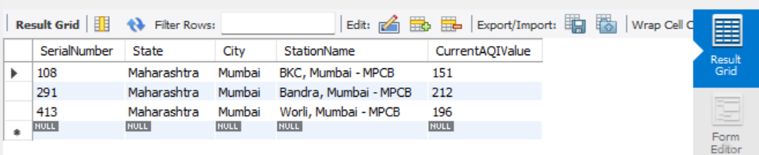
Output

Slide 6
2.Find the average AQI value of each state.
select State,Avg(CurrentAQIValue) as AvgAQI from airquality group by State;

Slide 7
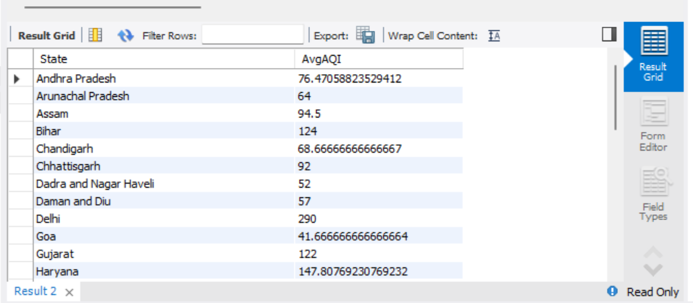
Output

Slide 8
3.Places where AQI value create health alert i.e. AQI>200
select city, CurrentAQIValue from AirQuality where CurrentAQIValue >200 order by CurrentAQIValue desc;

Slide 9
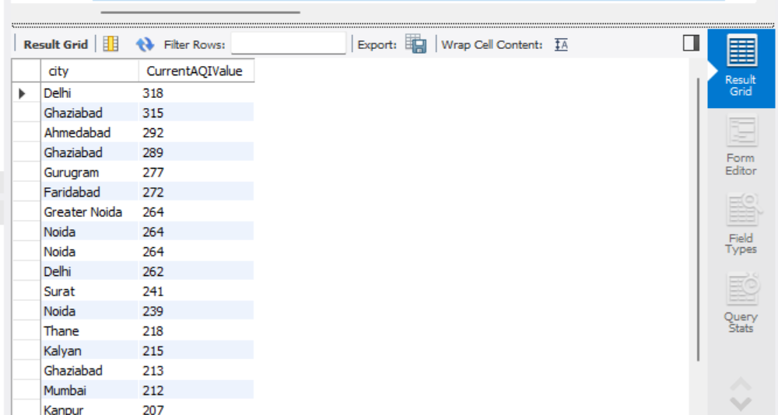
output

Slide 10
4.Calculate the overall average AQI
select avg(CurrentAQIValue) from AirQuality;

Slide 11
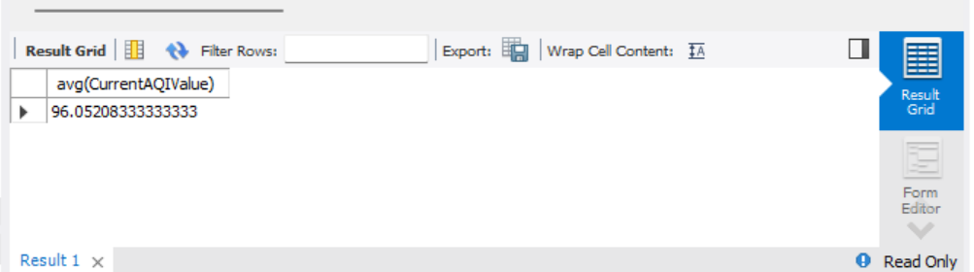
Output

Slide 12
5.Find the healthiest cities
select city,CurrentAQIValue from AirQuality where CurrentAQIValue<50 order by CurrentAQIValue asc;

Slide 13
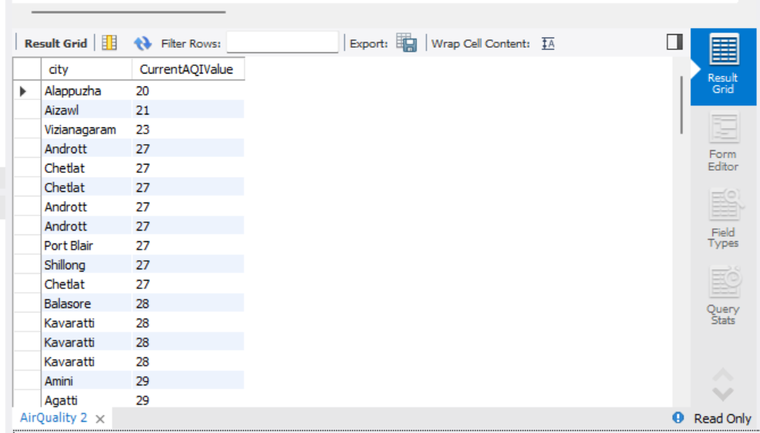
output

Slide 14
THANK YOU

